Slide 1
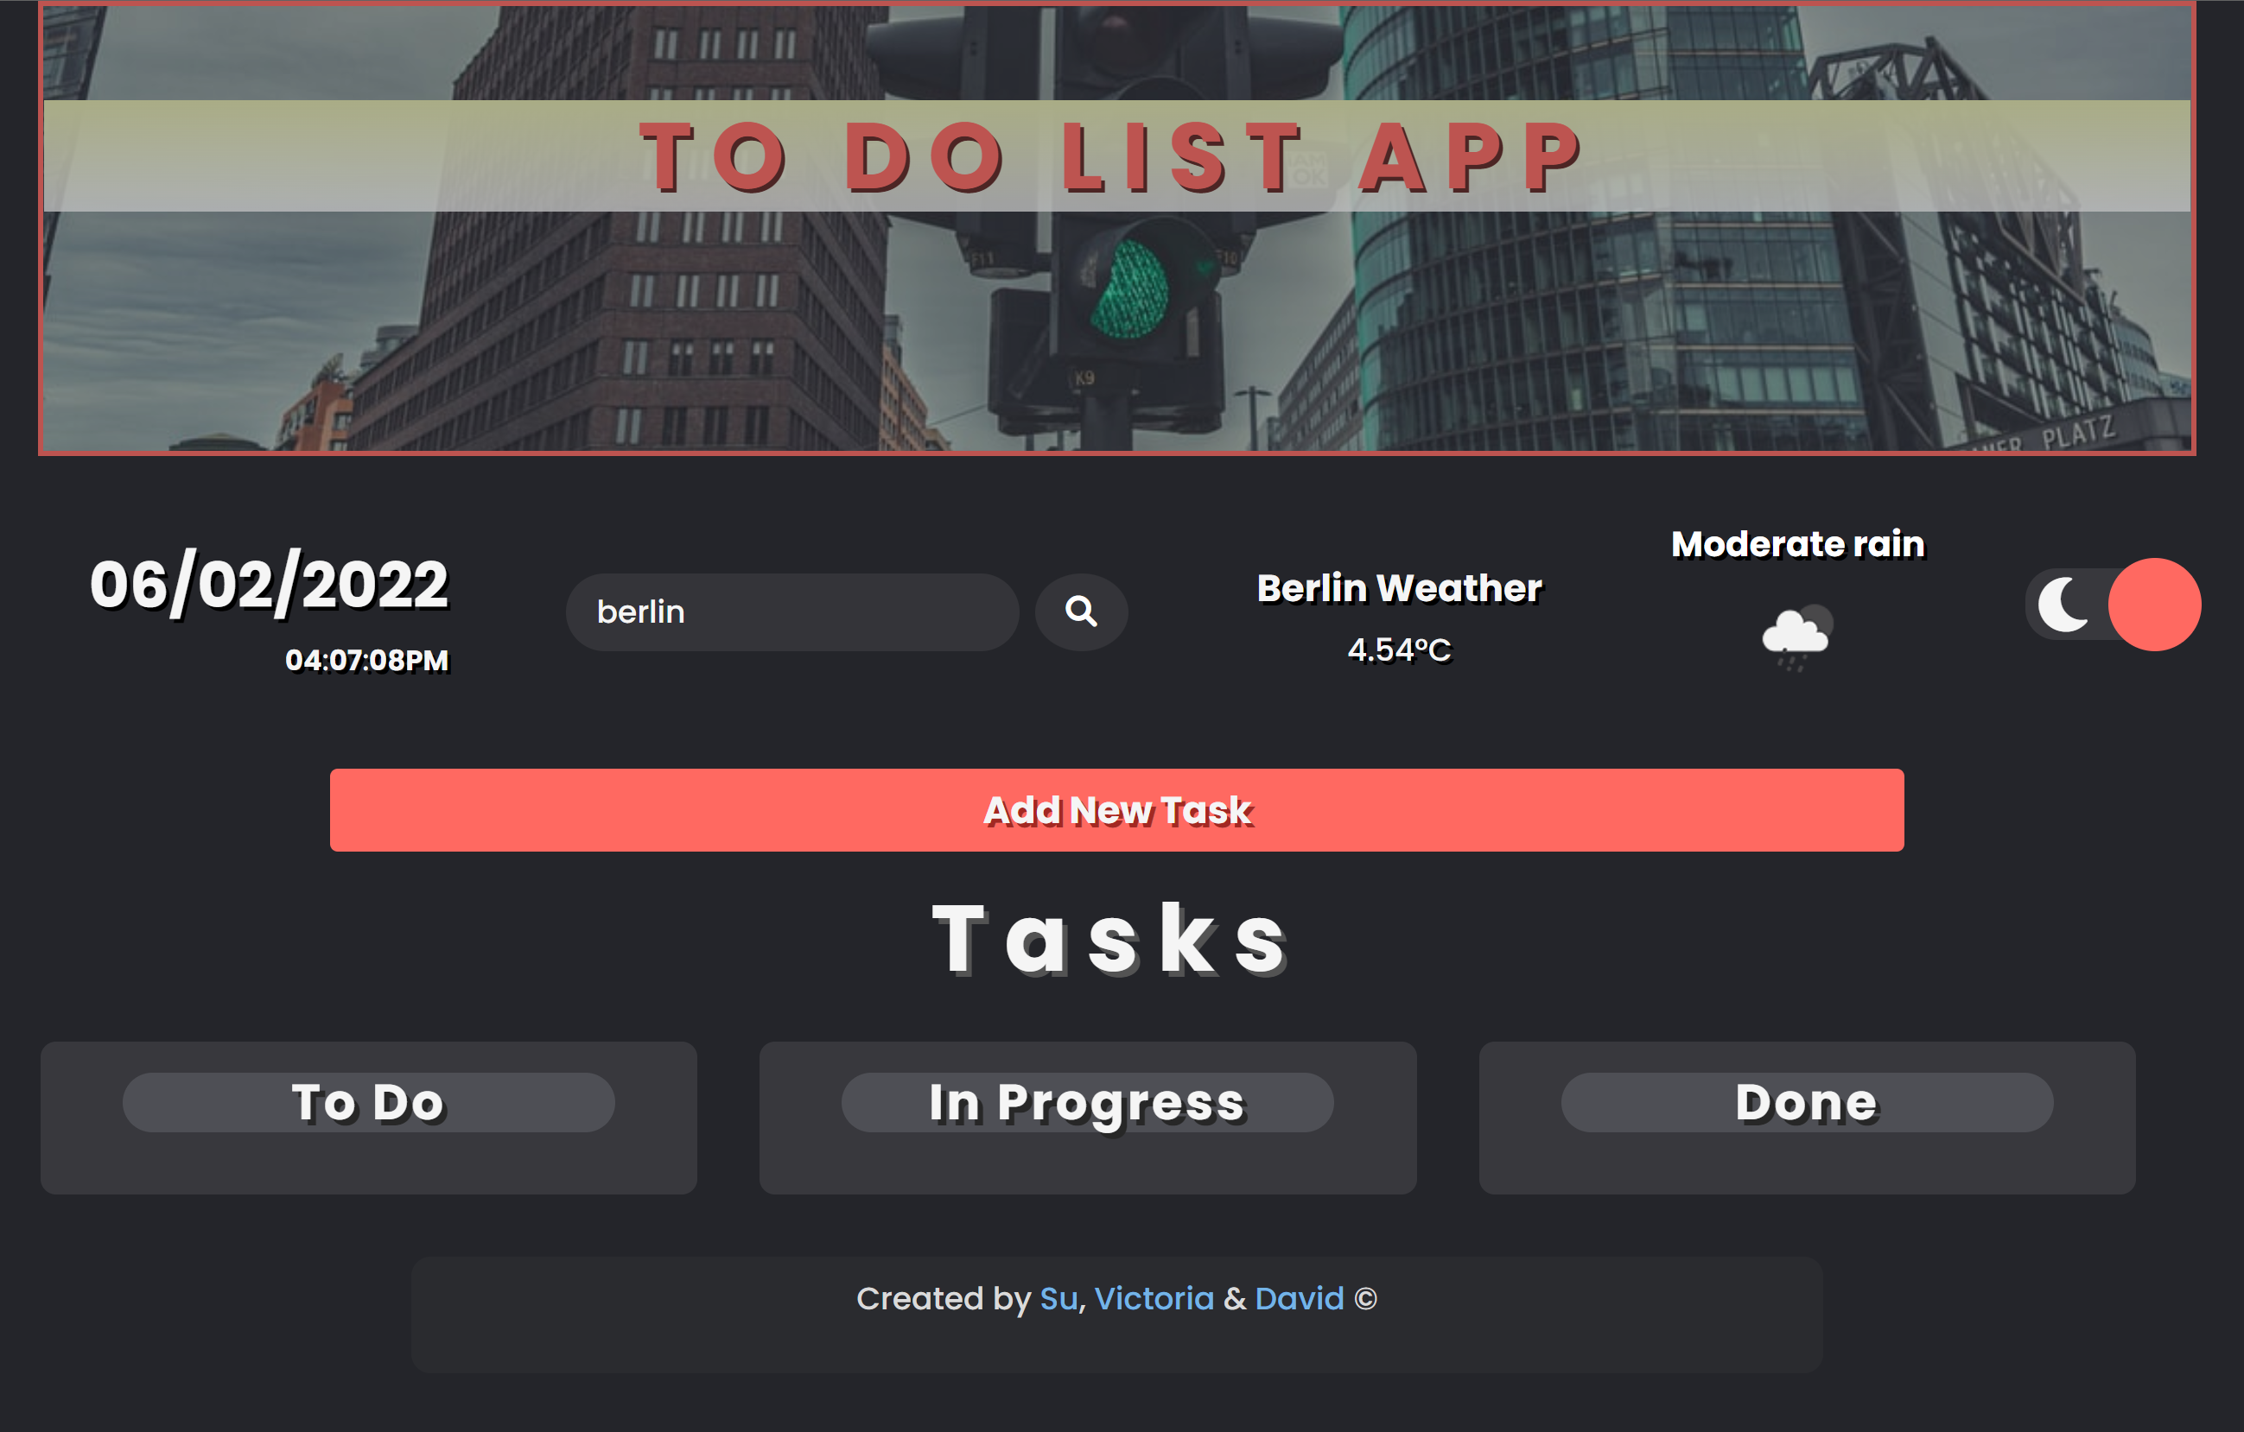

Slide 2
Project Team Structure
Project Team
Code Reviewer (all)
Su
Victoria
David

Slide 3

Agenda
1 : Design Analysis (including OOP Design )
Use Case Diagram, Class Diagram
2 : Agile Project Methodology + Tech Stack + Code
Pair Programming, Code Review, Git and GitHub
Code – Pair Programming and tech stack
App Demo
3 : Sprint – 2 & 3
4 : Additional features
Weather API - Open Weather
Unplash API
Light and Dark mode
Drag and Drop API
5: GitHub + Lessons learned

Slide 4
Design Analysis
Sprint -2
Task 4- Task form Input Validation
Task 5 – Displaying Date
Task 6 – Create a class using JavaScript
Sprint-3
Task 8 – Update Tasks
Task 9 – Persisting Task with Local Storage
Task 10 – Deleting Tasks
Task 7 – Display Tasks

Slide 5

OOP Design Analysis: Use Case Diagram
Use Cases
Render
Add task
Edit Task
System
Delete Task
User
Save tasks
Mark as Done
Local Storage/ Database

Slide 6
OOP Design Analysis: Class Diagram
Task Manager
+ tasks : Array + currentId : number
- addTask( ) - editTask( ) - deleteTask( ) - createTaskHTML( ) - formatStatus( ) - render( ) - getTaskById( ) - save( ) - load( )
UML Conventions
ClassName
property_name : type
method( ) : type

Slide 7
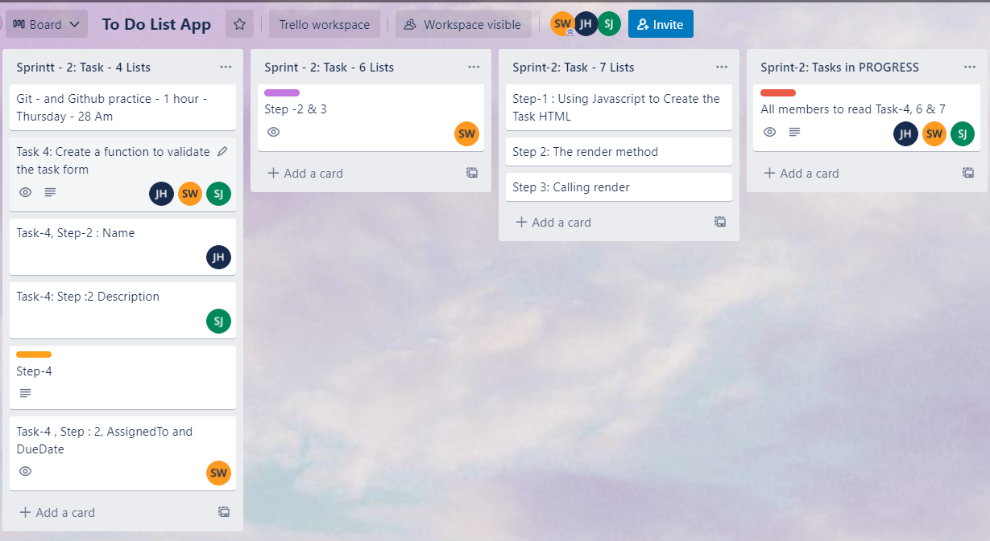
Agile Project Methodology - Trello
D
V
D
D
V
V
D
V
D
V

Slide 8
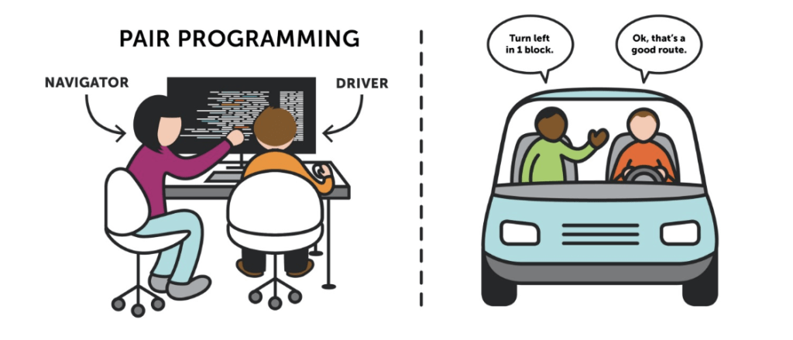
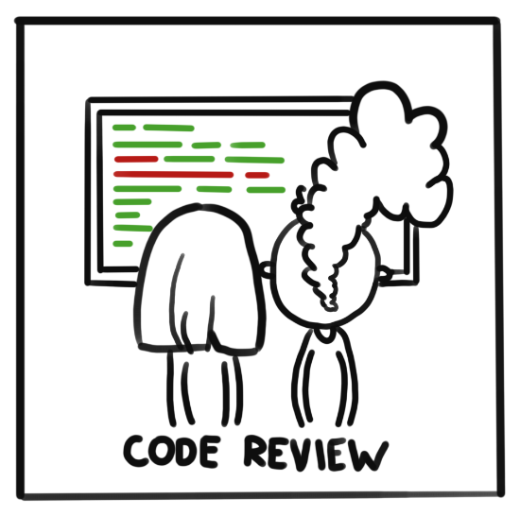




Technology Stack + Code Review

Slide 9
DEMO

Slide 10



(1) Additional Feature : Weather API
Weather Data display
4
Search Weather
To Do List App calling
Open Weather API
1
3
2
API fetch and access data

Slide 11
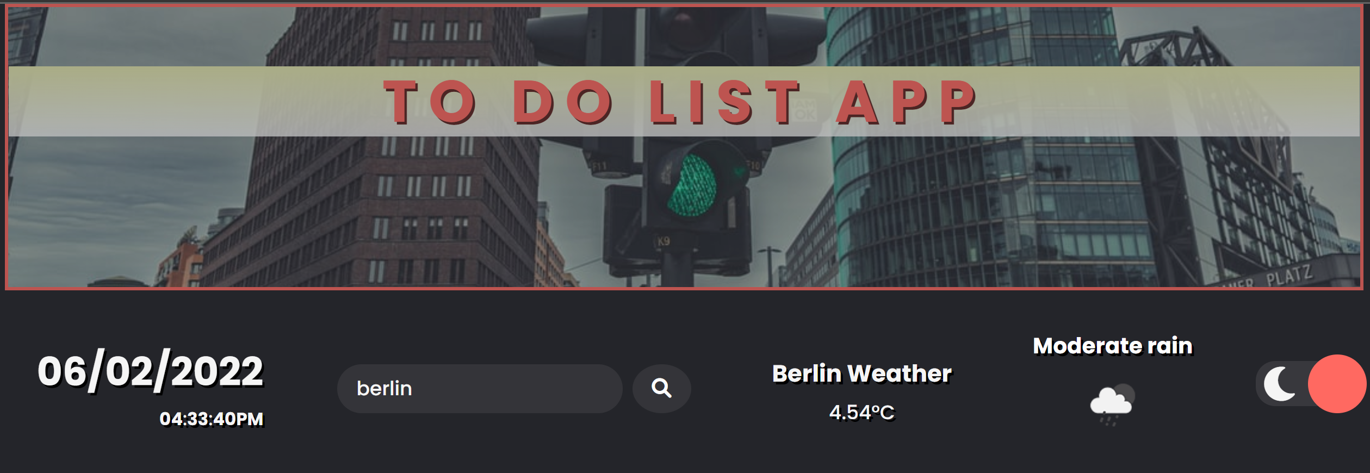
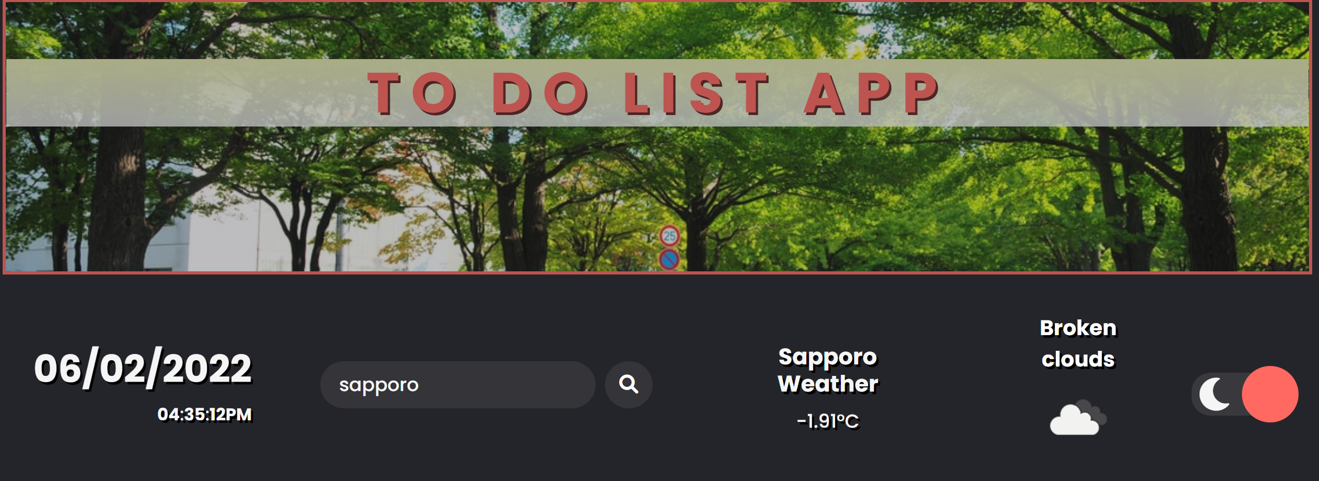
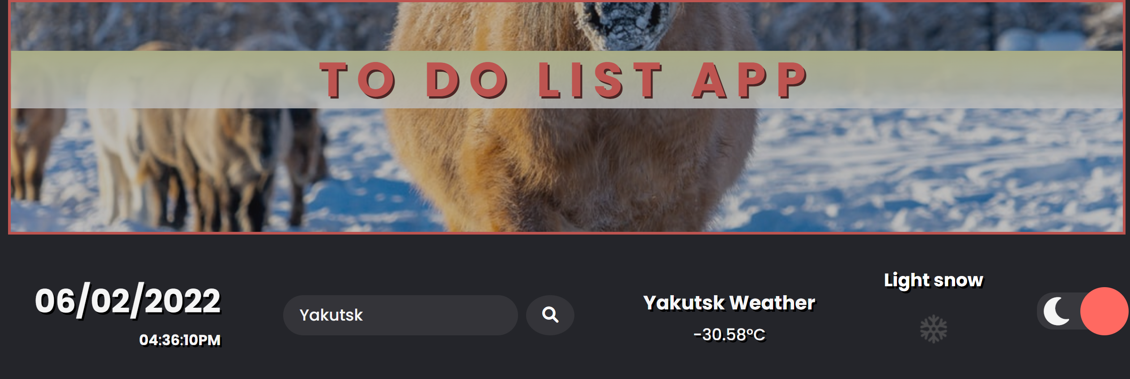
(2) Additional Feature : Unplash Image API
document.querySelector(".heading").style.backgroundImage = "url('https://source.unsplash.com/1110x400/?" + name + ")";

Slide 12
(2) Additional Feature : Unplash Image API
document.querySelector(".heading").style.backgroundImage = "url('https://source.unsplash.com/1110x400/?" + name + ")";

Slide 13


(3) Additional Feature : Light and Dark mode
<input type="checkbox” class="checkbox" id="checkbox" />
Font awesome – moon and sun
Light-dark toggle
Checkbox click event
🌙
🌞

Slide 14
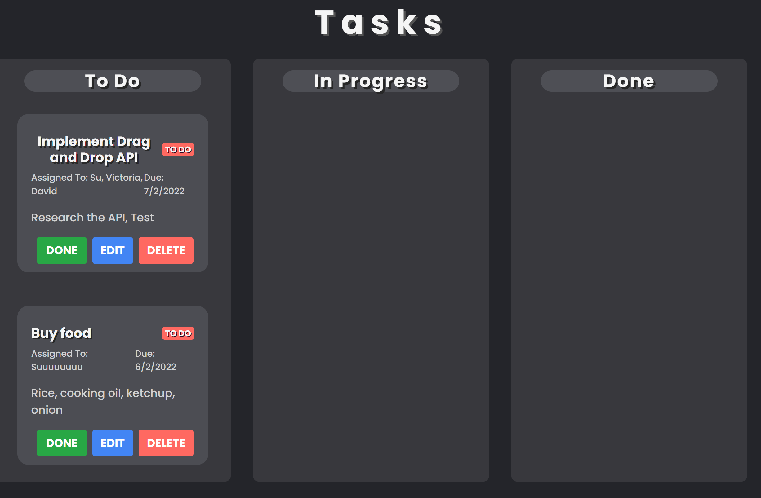
(4) Additional Feature : Drag and Drop API
Draggable
Each To Do list needs to be Draggable
Drop Target
Drop Target

Slide 15
(4) Additional Feature : Drag and Drop API
Draggable
Drop Target
Events
dragStart
dragOver
dragEnter
Attributes
ondragstart="dragStart(event)" draggable="true”
Events
dragOver
dragDrop
Update status
save( )
render( )

Slide 16
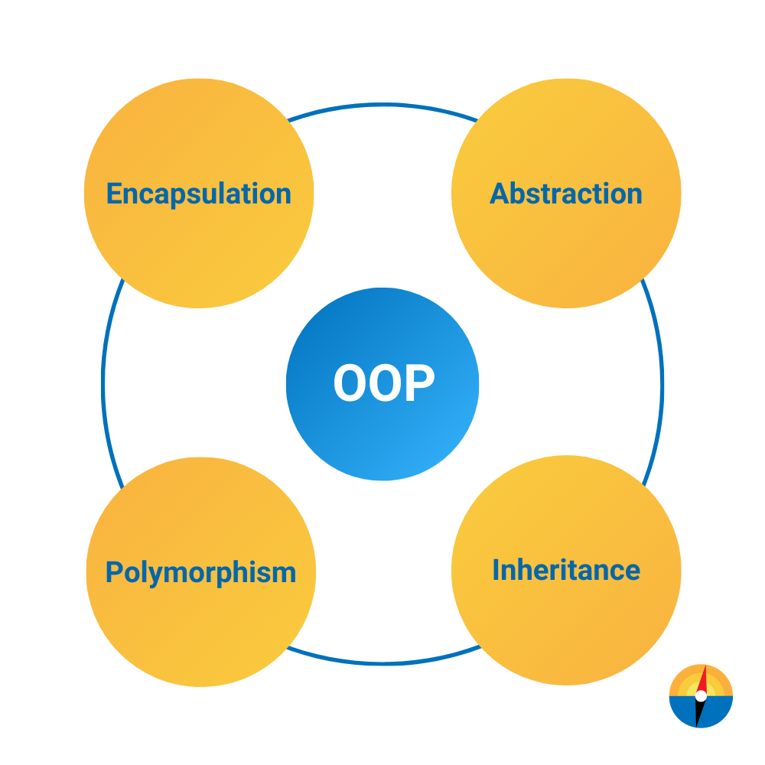


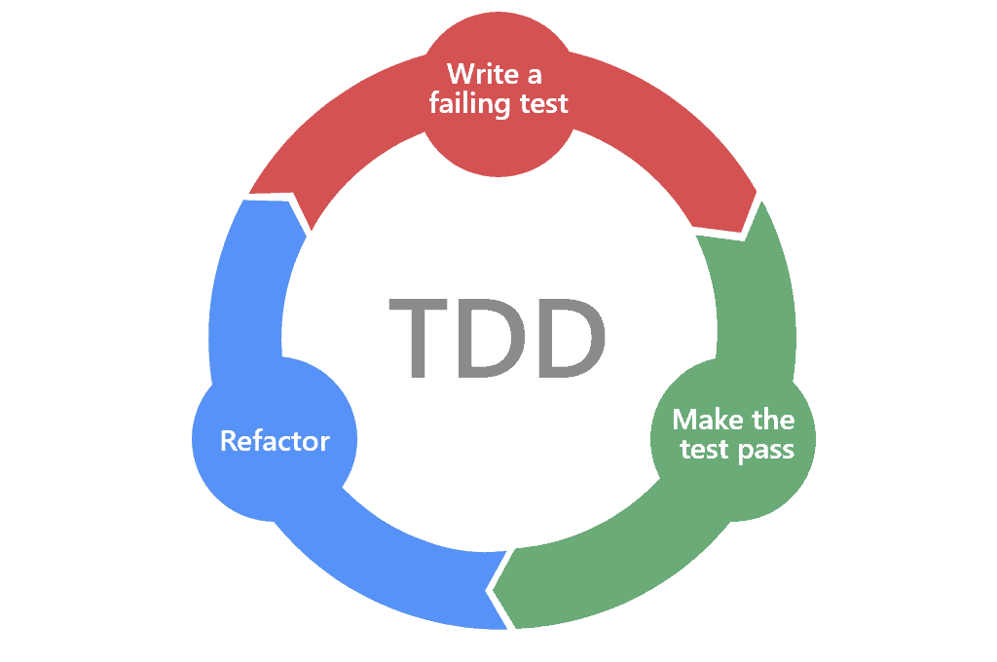

Lessons Learned
Agile Project Methodology &
Team Work
Debugging Sills
&
What TDD is
JavaScript
&
API calling
OOP Design Principles
Particularly
Encapsulation

Slide 17

Thanks!

